Slide 1


Numeric data of TV shows and movies on Netflix
By Lisa Han Huynh
1. Understanding which countries have produced films on Netflix
2. Network analysis of Actors / Directors and find interesting insights
3. Does Netflix has more focus on TV Shows than movies in recent years?

Slide 2
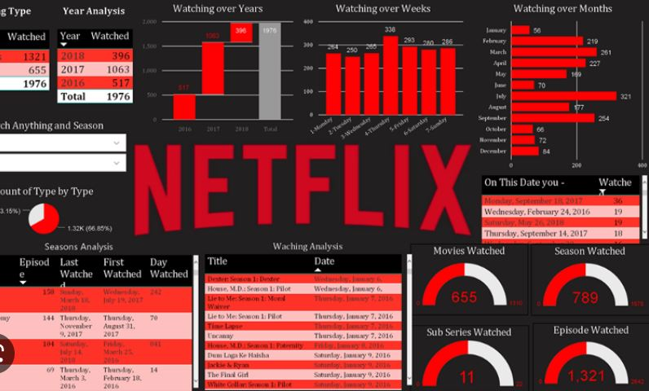
Data TV shows and movies on Netflix
Show Types are available.
Number of films & TV shows from 2015 to 2021
Top 10 Directors.
Top 10 Cast members (actors involved in shows or movies)
Top 10 countries that contributed films on Netflix

Slide 3


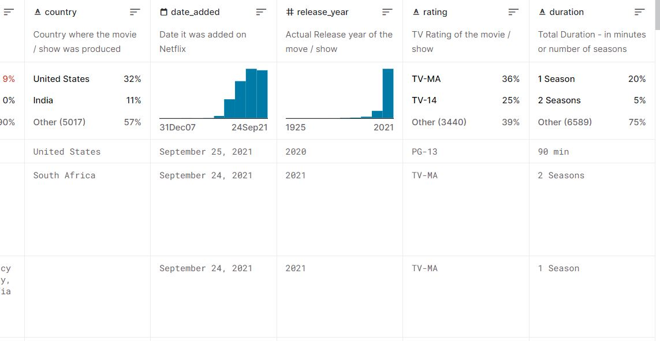

Data set
Data is used from Kaggle by CSV file that i converted from CSV to Sqlite DB for the analysis purpose. This is a tabular dataset that consists of listings of all the movies and tv shows available on Netflix, along with details such as - cast, directors, ratings, release year, duration, etc. with over 8,000 details of movies and TV shows.
Netflix Movies and TV Shows from Kaggle

Slide 4
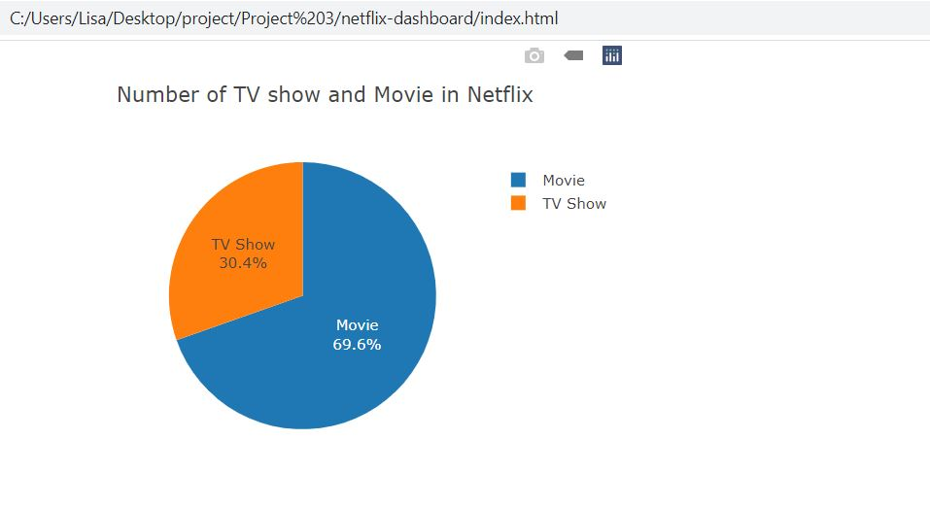
Percentage of the TV shows and movies on Netflix
Netflix is known as one most popular video and media
Platforms to watch movies.
TV show 30.4%
Movie ‘s reached 69.5%

Slide 5
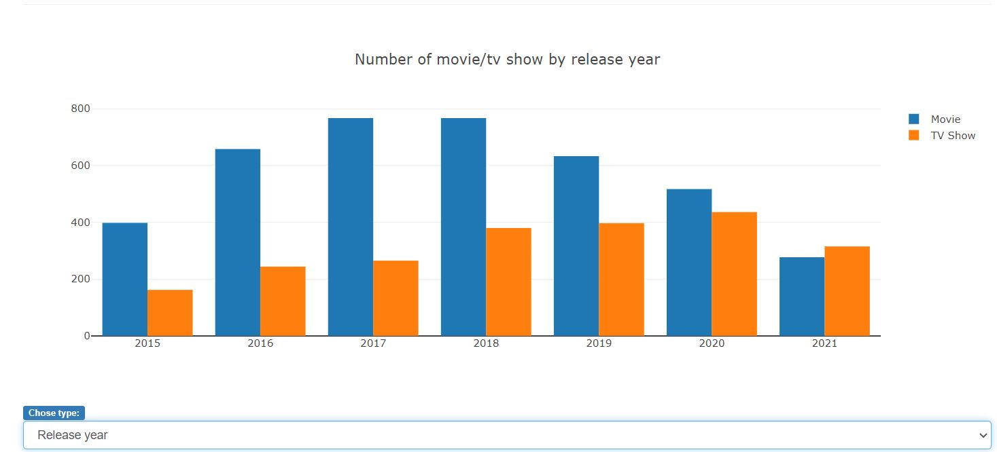
Does Netflix have more focus on TV Shows than movies in recent years?
From 2020 through 2021:
2020:
TV show 436
Movie: 517
2021:
TV show: 277
Movie: 315
According to the chart, we may see Netflix is trying to focus on TV shows.

Slide 6
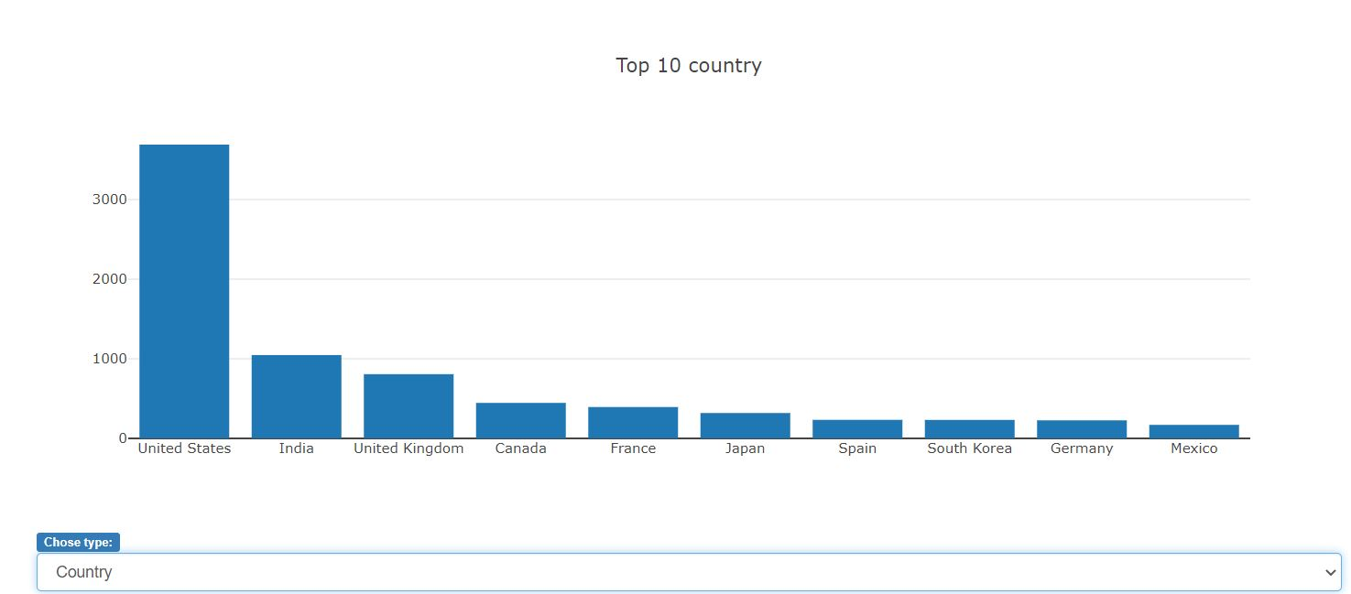
Understanding country which was produced films on Netflix:
Top 10 countries that have contributed films on Netflix:
1. United States: 3,690
………
……..
10. Mexico: 169

Slide 7
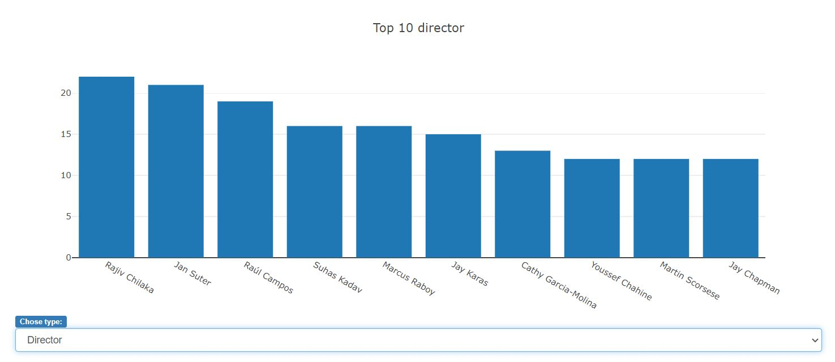
Network analysis of Actors / Directors and find interesting insights
Top 10 Director of movies on Netflix:
1.Rajiv Chilaka : 22
…
10.Yay Chapman : 12

Slide 8
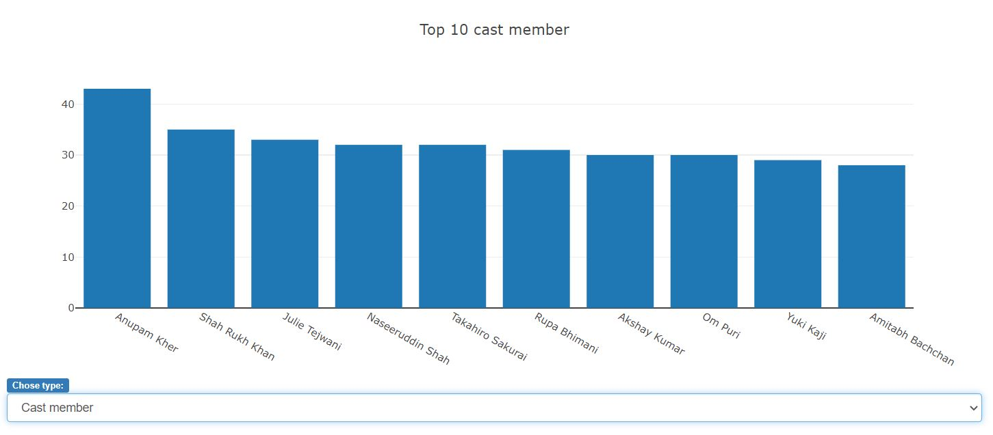
Network analysis of Actors / Directors and find interesting insights
Top 10 Actors involved in the movies/show:
1. Anupam Kher: 43
…
10.Amitanh Backchan : 28

Slide 9

SUMMARY
1. Which countries have contributed films on Netflix:
U.S., India, U.K, Canada, France, Japan, Spain, and South Korea..
U.S has the highest-produced films on Netflix
2. Network analysis of Actors / Directors and find interesting insights:
While the highest-produced films on Netflix is the U.S., the top of actor and director involved in the movies are Indian.
3.Does Netflix has more focus on TV Shows than movies in recent years?
From 2020 through 2021, Netflix has strived to pull TV shows as much as Movies.

Slide 10


Thank You

